Slide 1
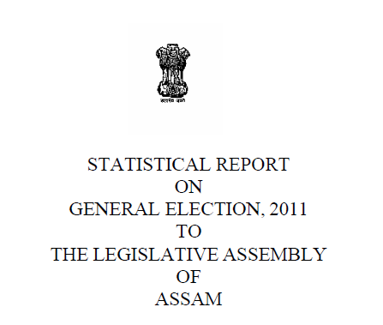
ECI Parser

Slide 2
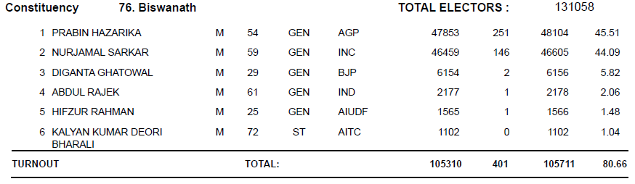
Aim Of the project
Read .pdf files from http://eci.nic.in/.
Extract information regarding the all the participants of each constituency.
Categorize data in different sections, according to the choice of the user.

Slide 3
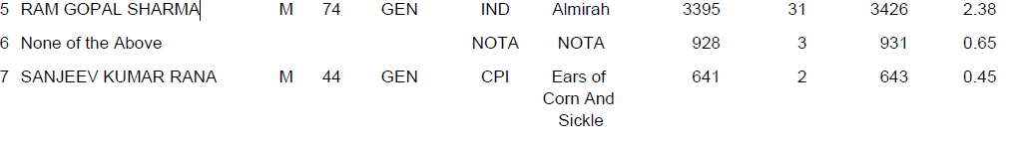
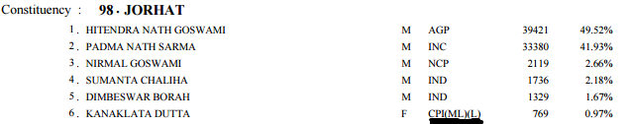
Exceptional Cases
Create adjustments for cases where voters chose not to vote for any political party
Party names with brackets

Slide 4
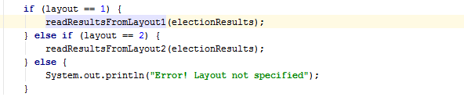
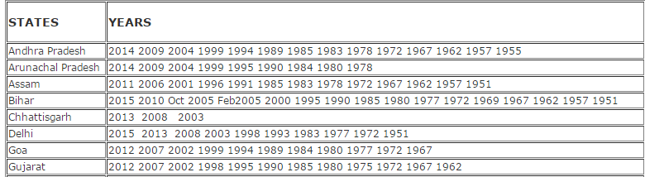
Layouts
Users have option of reading two different layouts
With the effective use of both of these layouts, the
program can handle election files from 2000 to 2016.

Slide 5
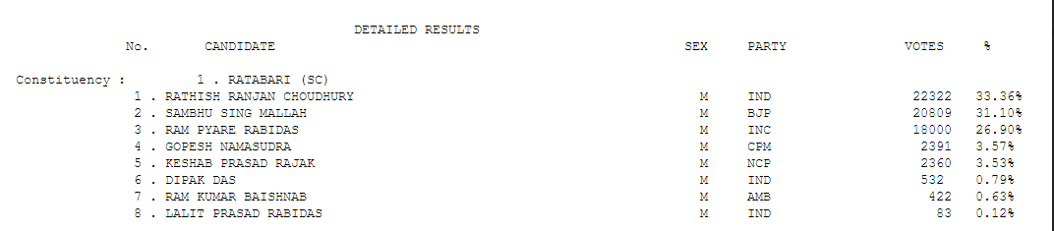
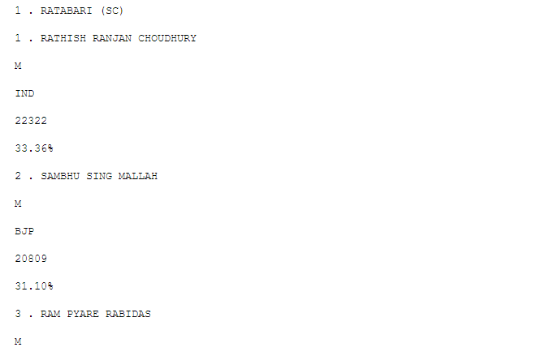
Different Kinds of Layout(Assam 2001)

Slide 6

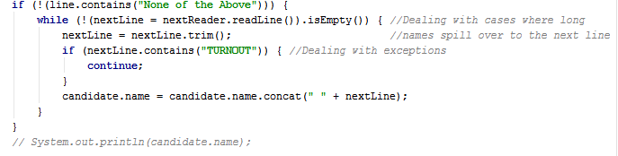
Regular Expressions
java.util.regex
Used for pattern matching using our own specialized syntax
Some of exceptions were handled separately.

Slide 7
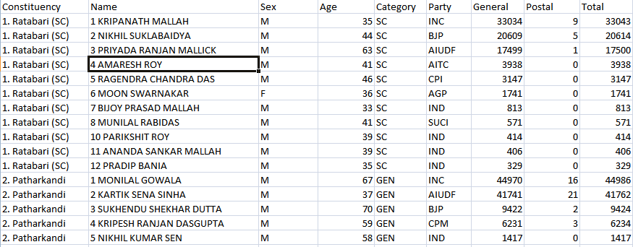
Final Output
The user may choose to remove some of the elements from the output file.
Final output is a .csv file which can be used in other programming languages to analyze statistical data.

